Slide 1

Web Application Development
COMP-229
Fall 2023

Slide 2
Folder Structure for Modern Web Applications
It is critical to create a maintainable folder structure while developing web apps, having the right files in the correct folder helps organize your code and makes other developers have an idea of how the architecture of your web application is or will be during development.
Maintaining a well-organized folder structure is crucial when developing web applications, even though it may not be the first thing that comes to mind when working alone or with few resources.

Slide 3
Some Tips In Designing Your Folder Structure
Understand the purpose of your web project: In order to figure out how to organize your web project, you will need to establish a good understanding of what you have, depending on how many assets you are trying to organize and the features in your web applications.
Use proper naming convention for your folders and files, they should be descriptive of the purpose in your web application.

Slide 4
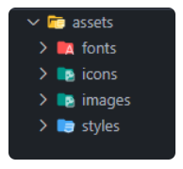
Folder Structures and their explanation
Assets The assets folder contains all images, icons, css files, font files, etc. that will be used in your web application. Custom images, icons, paid fonts are being placed inside this folder.

Slide 5
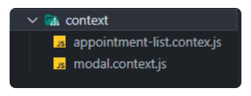
Context When using React Js as your preferred frontend ui library, the context folder stores all your react context files that are used across components and multiple pages.

Slide 6
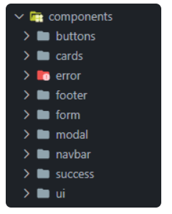
Components The components folder holds the UI for your application. It contains all our UI components like navbar, footer, buttons, modals, cards, etc.

Slide 7
Composables In the context of Vue applications, a "composable" is a function that leverages Vue's Composition API to encapsulate and reuse stateful logic.
Data The data folder is used for storing text data which will be used in different sections and pages as JSON files. Doing this will enable updating of information easier.

Slide 8
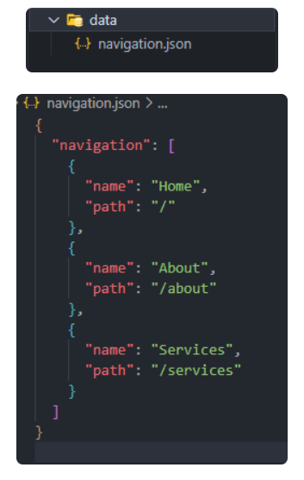

Slide 9
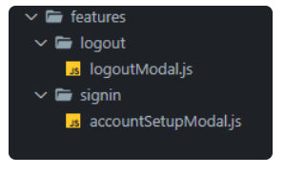
Features This folder contains individual folder feature for each page (authentication, theme, modals). For example each page might have a modal feature.

Slide 10

Hooks Hooks are functions that let you “hook into” React state and lifecycle features from function components. Also we can create custom hooks whose name starts with 'use' and can be used to call other hooks.

Slide 11
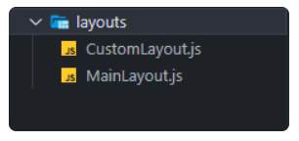
Layouts When defining the general look and feel of the web page, the Layouts folder comes in handy. It is used to place layout-based components such as the sidebar, navbar, and footer. If your web application has many layouts, this folder is a fantastic place to save them.

Slide 12
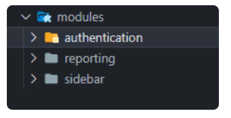
Modules Modules folder handles specific tasks in your application.

Slide 13
Pages The pages directory contains your web application views. Pages directory in frontend frameworks like Next Js and Nuxt Js reads all files inside the directory and automatically creates the router configuration for you.
Public The public directory is directly served at the server root and contains public files that won't change e.g favicon.ico.
Routes The routes folder is just a place in your web application to store the routes path to different screens.

Slide 14
Utility/Utils This folder is for storing all utility functions, such as auth, theme, handleApiError, etc.
Views Views folder are like the pages folder, The views are used to represent your pages properly, that users can navigate back and forth.
Main.js
file serves as the entry point of your application, enabling Vue initialization and configuration of plugins or additional libraries.

Slide 15
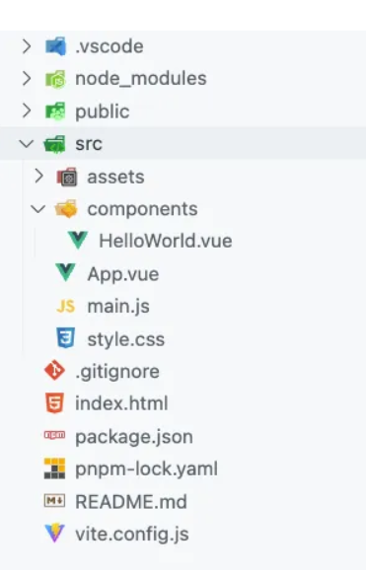
App.vue/App.js
file represents the root component of your application, acting as a container for other components and serving as the main template.

Slide 16
Config
Application configuration files.
features
Contains all the application features. We want to keep most of the application code inside here
Layouts
Different layouts for the pages.

Slide 17
lib
Configurations for different third-party libraries that are used in our application.
Pages
The pages of our application.
Services
Shared application services and providers.
Stores
Global state stores.
test
Test-related mocks, helpers, utilities, and configurations.
types
Shared TypeScript type definitions.

Slide 18
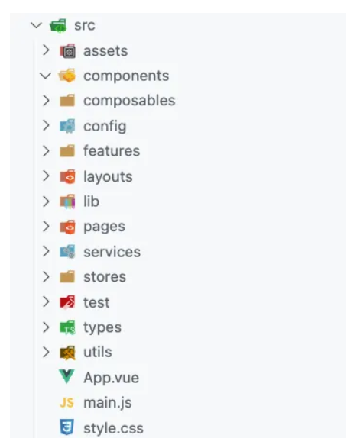
Utils
Shared utility functions.

Slide 19
File Structure
Is there a recommended way to structure React projects?
React doesn’t have opinions on how you put files into folders. A few common approaches popular in the ecosystem that may be considered.
Grouping by features or routes
Grouping by file type
One common way to structure projects is to locate CSS, JS, and tests together inside folders grouped by feature or route.

Slide 20
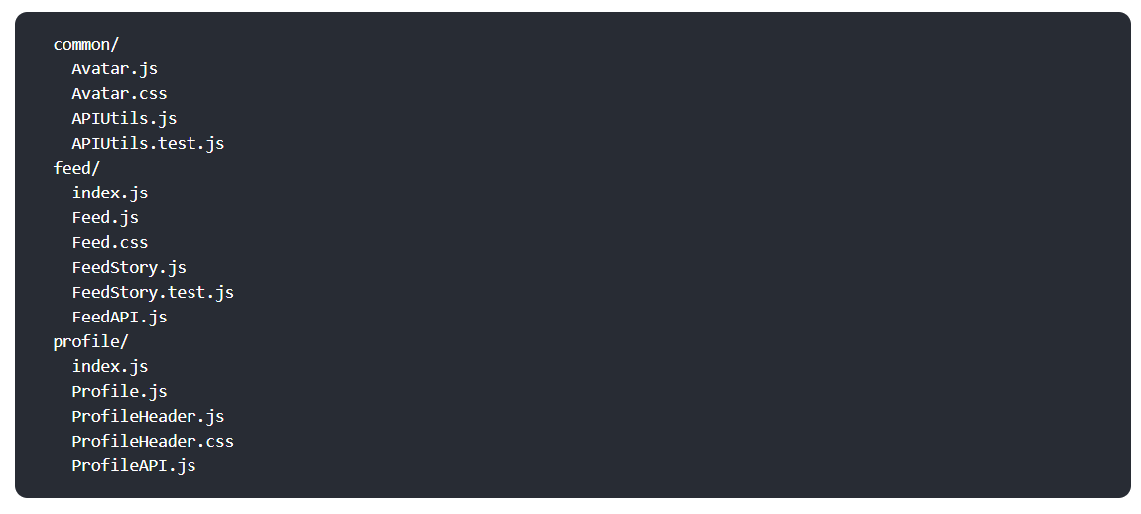
Grouping by features or routes
One common way to structure projects is to locate CSS, JS, and tests together inside folders grouped by feature or route.

Slide 21
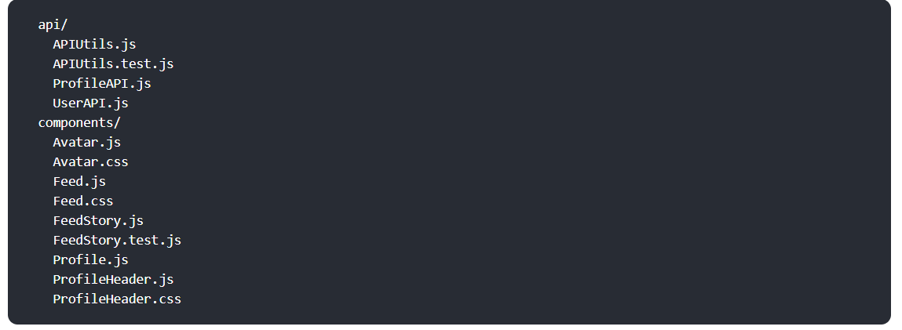
Grouping by file type
Another popular way to structure projects is to group similar files together, for example:

Slide 22
Avoid too much nesting
There are many pain points associated with deep directory nesting in JavaScript projects. It becomes harder to write relative imports between them, or to update those imports when the files are moved.
Unless you have a very compelling reason to use a deep folder structure, consider limiting yourself to a maximum of three or four nested folders within a single project.
it is a good idea to keep files that often change together close to each other. This principle is called “colocation”.

Slide 23
Conclusion
A good folder structure allows you and other developers to find files faster and manage them more easily. A well-organized folder structure makes you appear professional.

Slide 24
References
https://dev.to/noruwa/folder-structure-for-modern-web-applications-4d11
https://fadamakis.com/a-front-end-application-folder-structure-that-makes-sense-ecc0b690968b
https://legacy.reactjs.org/docs/faq-structure.html

